Slide 1
Network Theorems (AC)
ET 242 Circuit Analysis II
Electrical and Telecommunication
Engineering Technology
Professor Jang

Slide 2
Acknowledgement
I want to express my gratitude to Prentice Hall giving me the permission to use instructor’s material for developing this module. I would like to thank the Department of Electrical and Telecommunications Engineering Technology of NYCCT for giving me support to commence and complete this module. I hope this module is helpful to enhance our students’ academic performance.

Slide 3
OUTLINES
Introduction to Network Theorems (AC)
Thevenin Theorem
Superposition Theorem
Maximum Power Transfer Theorem
Key Words: Network Theorem, Thevinin, Superposition, Maximum Power
ET 242 Circuit Analysis II – Network Theorems for AC Circuits Boylestad 2

Slide 4
Network Theorems (AC) - Introduction
This module will deal with network theorems of ac circuit rather than dc circuits previously discussed. Due to the need for developing confidence in the application of the various theorems to networks with controlled (dependent) sources include independent sources and dependent sources. Theorems to be considered in detail include the superposition theorem, Thevinin’s theorem, maximum power transform theorem.
Superposition Theorem
The superposition theorem eliminated the need for solving simultaneous linear equations by considering the effects of each source independently in previous module with dc circuits. To consider the effects of each source, we had to remove the remaining sources . This was accomplished by setting voltage sources to zero (short-circuit representation) and current sources to zero (open-circuit representation). The current through, or voltage across, a portion of the network produced by each source was then added algebraically to find the total solution for the current or voltage.
The only variation in applying this method to ac networks with independent sources is that we are now working with impedances and phasors instead of just resistors and real numbers.
ET 242 Circuit Analysis II – Network Theorems for AC Circuits Boylestad 3
Notes:
Fig 12-1 a&b op-amp schem. symbols

Slide 5
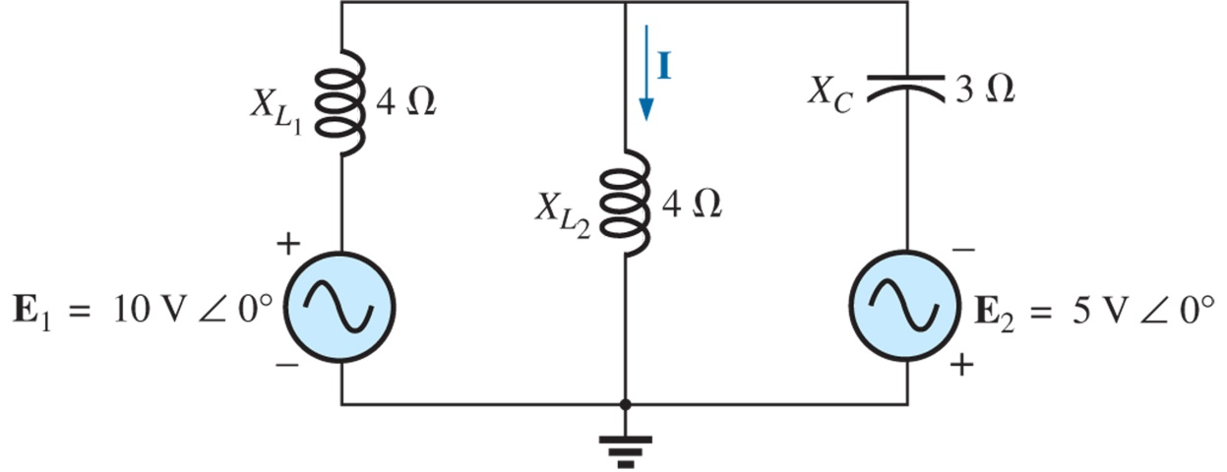
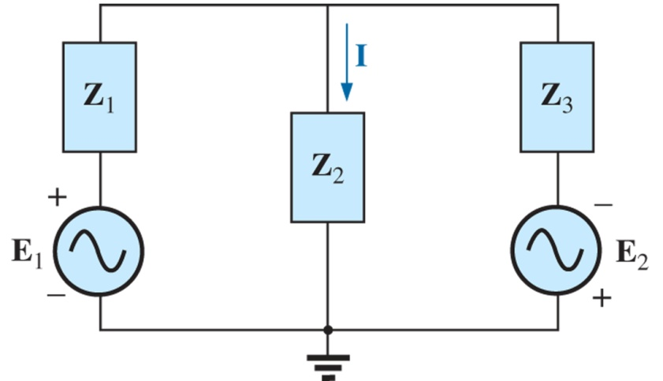
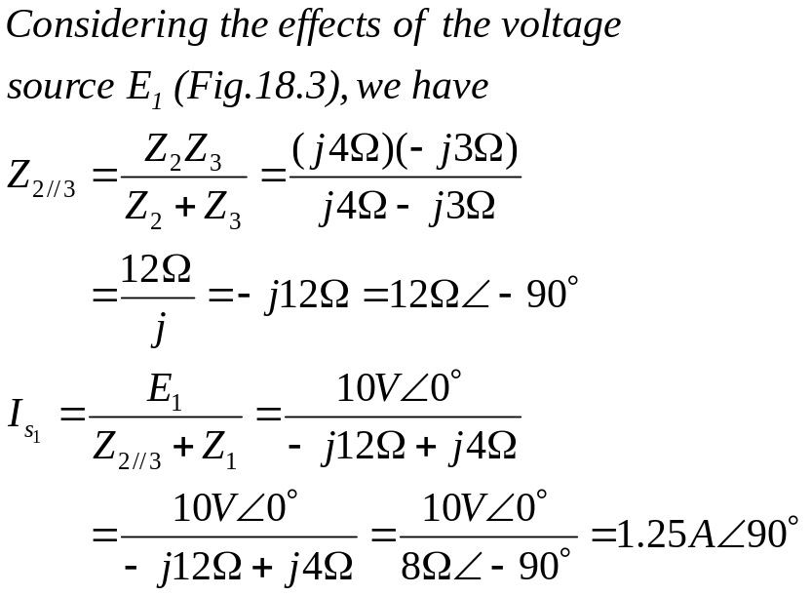
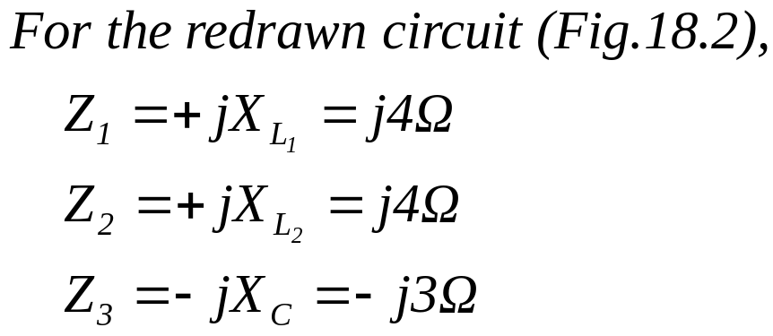
Independent Sources
Ex. 18-1 Using the superposition theorem, find the current I through the 4Ω resistance (X_{L2}) in Fig. 18.1.
Figure 18.1 Example 18.1.
Figure 18.2 Assigning the subscripted impedances to the network in Fig.18.1.
ET 242 Circuit Analysis II – Network Theorems for AC Circuits Boylestad 4

Slide 6
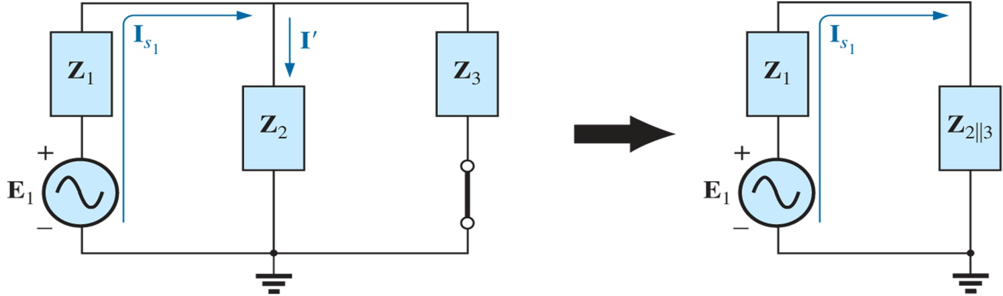
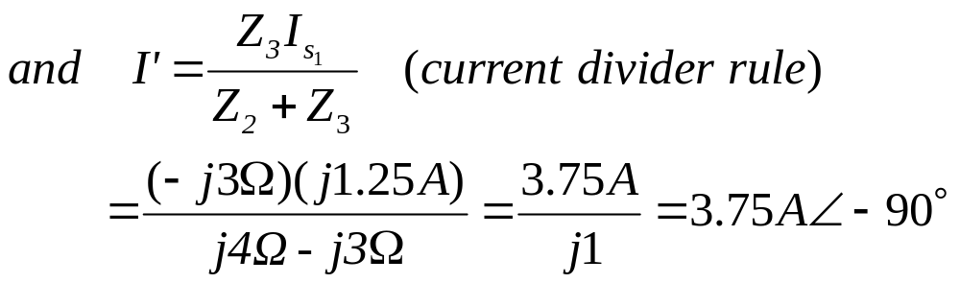
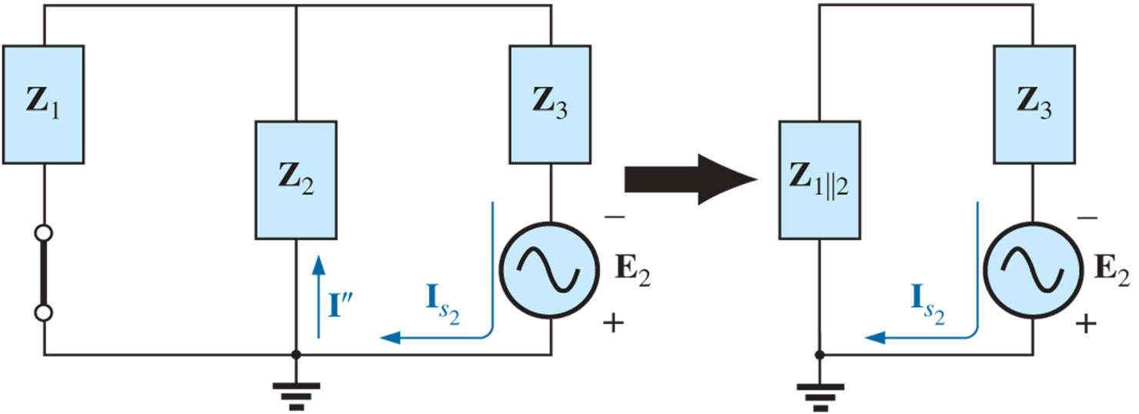
Figure 18.3 Determining the effect of the voltage source E₁ on the current I of the network in Fig. 18.1.
Figure 18.4 Determining the effect of the voltage source E₂ on the current I of the network in Fig. 18.1.
ET 242 Circuit Analysis II – Network Theorems for AC Circuits Boylestad 5

Slide 7
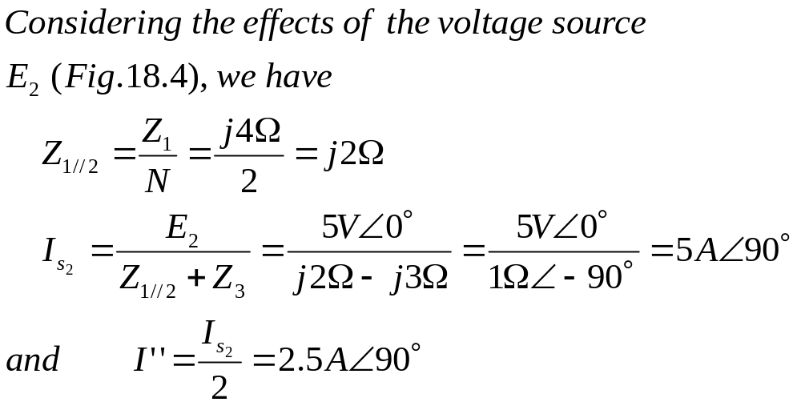
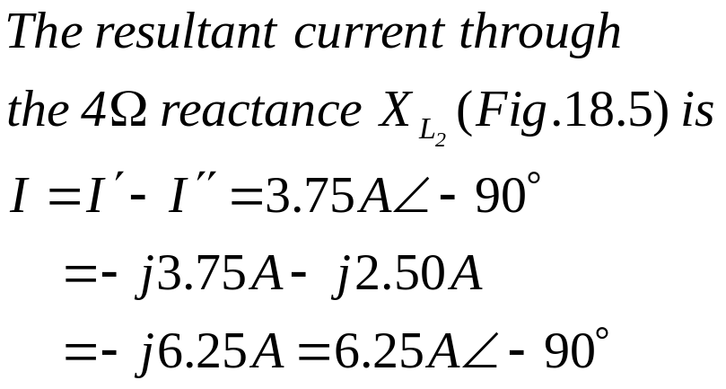
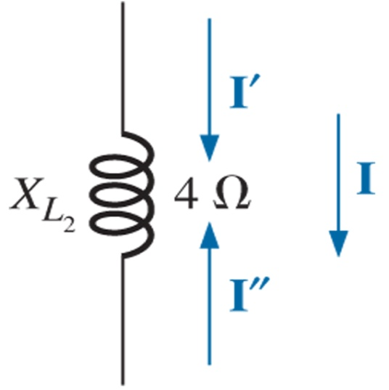
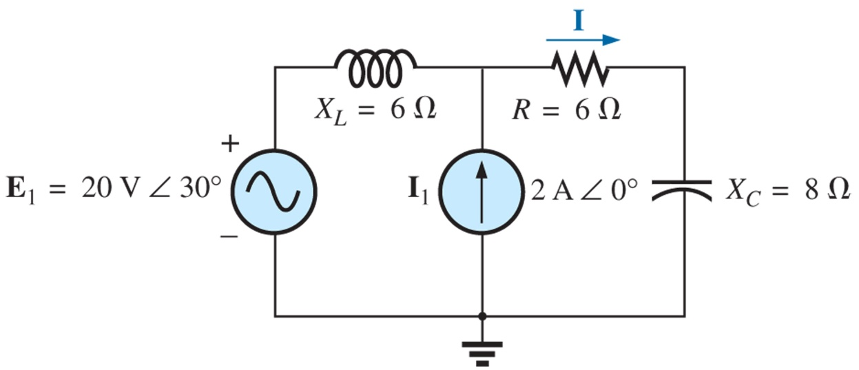
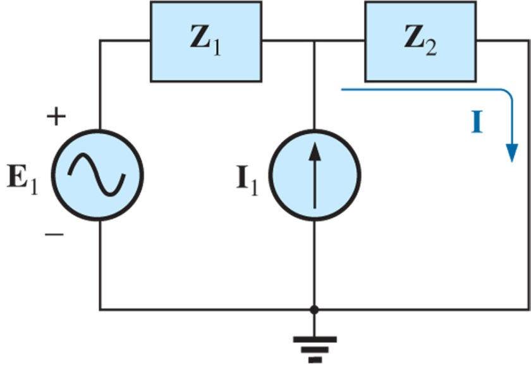
Figure 18.5 Determining the resultant current for the network in Fig. 18.1.
Ex. 18-2 Using the superposition, find the current I through the 6Ω resistor in Fig.18.6.
Figure 18.6 Example 18.2.
Figure 18.7 Assigning the subscripted impedances to the network in Fig.18.6.
ET 242 Circuit Analysis II – Network Theorems for AC Circuits Boylestad 2

Slide 8
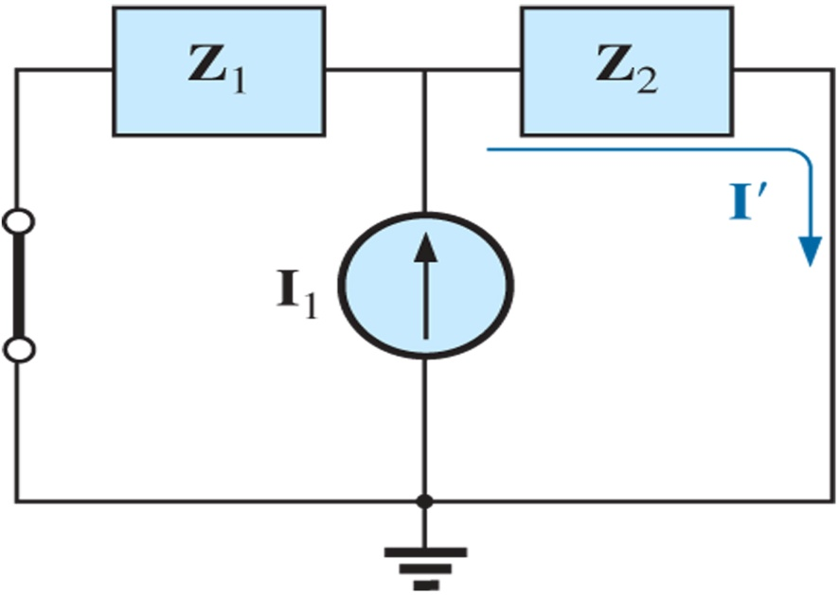
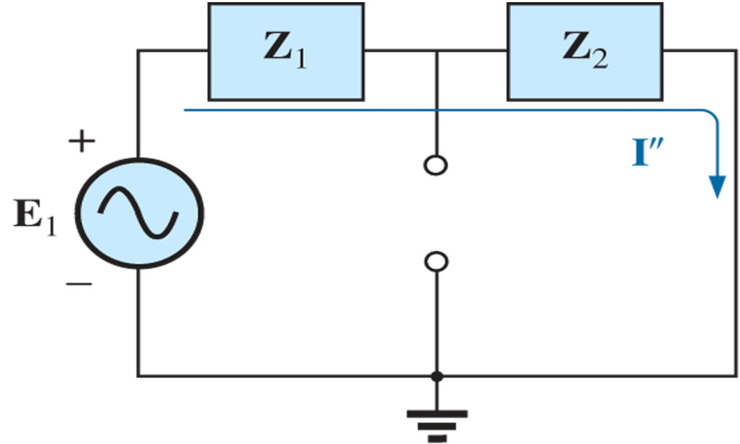
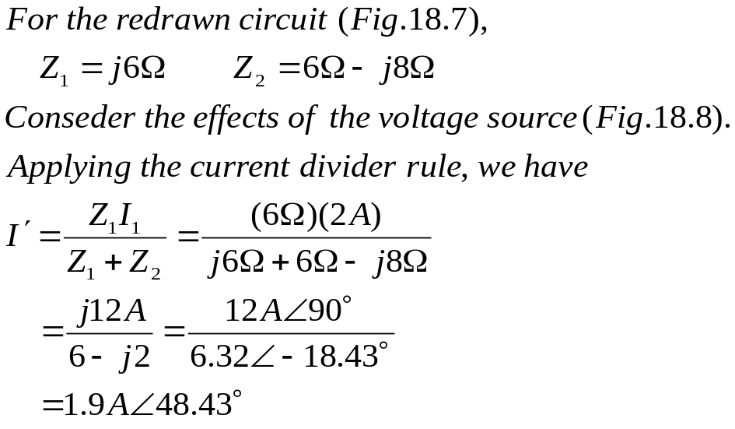
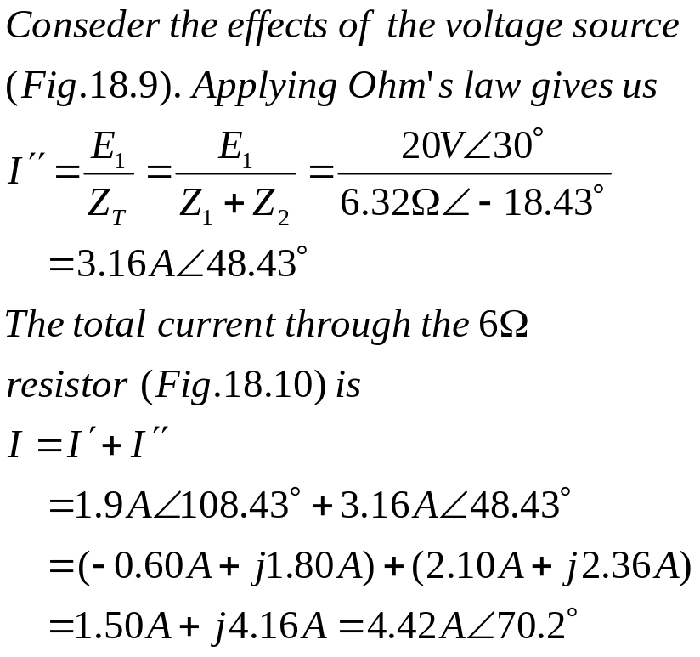
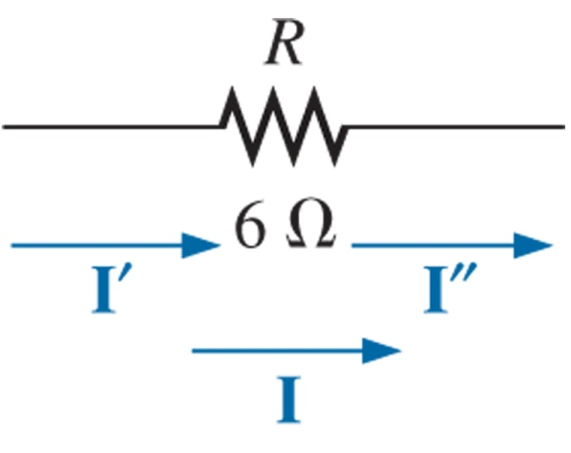
Figure 18.8 Determining the effect of the current source I₁ on the current I of the network in Fig.18.6.
Figure 18.9 Determining the effect of the voltage source E₁ on the current I of the network in Fig.18.6.
Figure 18.10 Determining the resultant current I for the network in Fig. 18.6.
ET 242 Circuit Analysis II – Parallel ac circuits analysis Boylestad 2

Slide 9
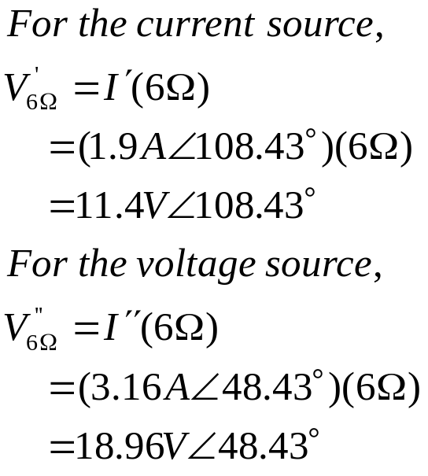
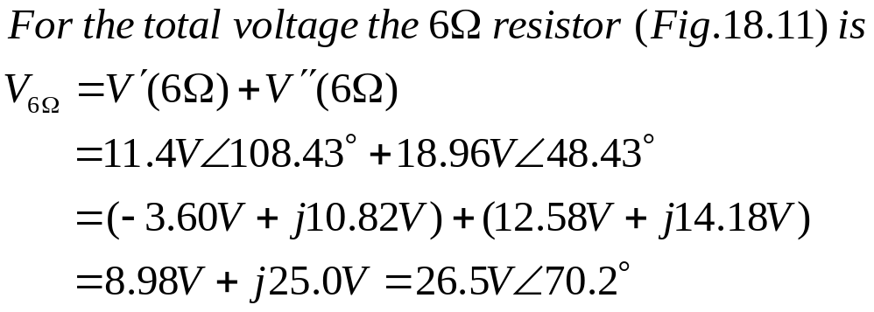
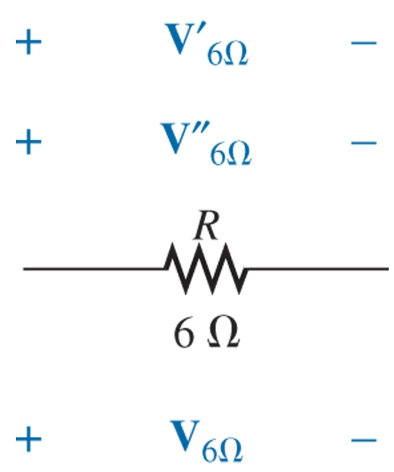
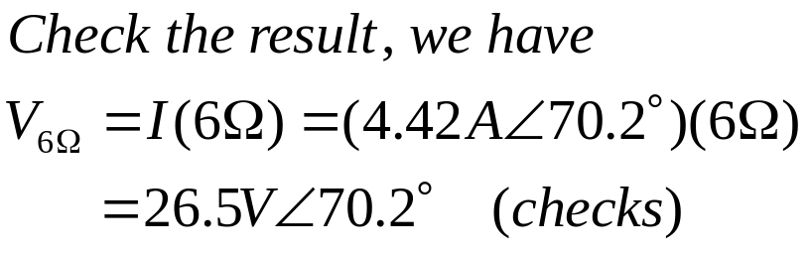
Ex. 18-3 Using the superposition, find the voltage across the 6Ω resistor in Fig.18.6. Check the results against V_{6Ω} = I(6Ω), where I is the current found through the 6Ω resistor in Example 18.2.
Figure 18.6
Figure 18.11 Determining the resultant voltage V_{6Ω} for the network in Fig. 18.6.
ET 242 Circuit Analysis II – Network Theorems for AC Circuits Boylestad 8

Slide 10
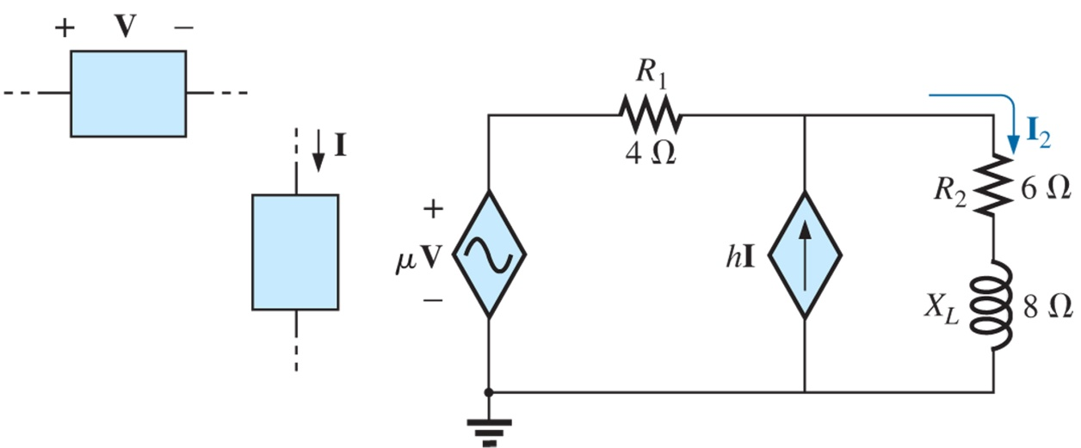
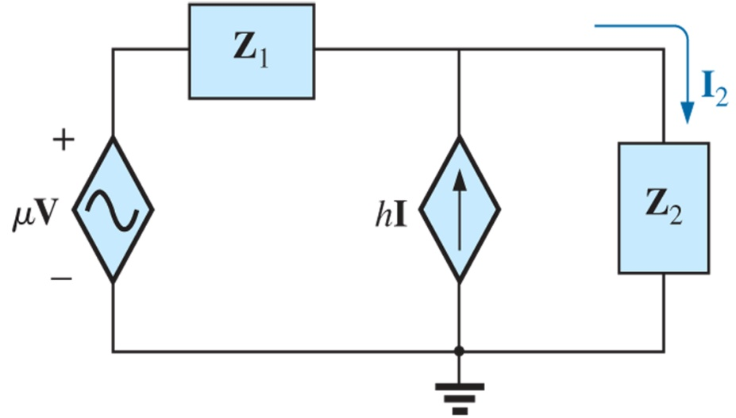
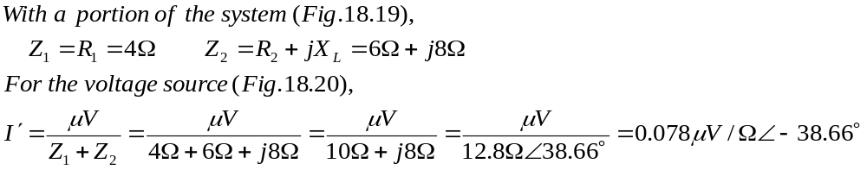
Dependent Sources For dependent sources in which the controlling variable is not determined by the network to which the superposition is to be applied, the application of the theorem is basically the same as for independent sources.
Ex. 18-5 Using the superposition, determine the current I₂ for the network in Fig.18.18. The quantities μ and h are constants.
Figure 18.18 Example 18.5.
Figure 18.19 Assigning the subscripted impedances to the network in Fig.18.18.
ET 242 Circuit Analysis II – Network Theorems for AC Circuits Boylestad 9

Slide 11
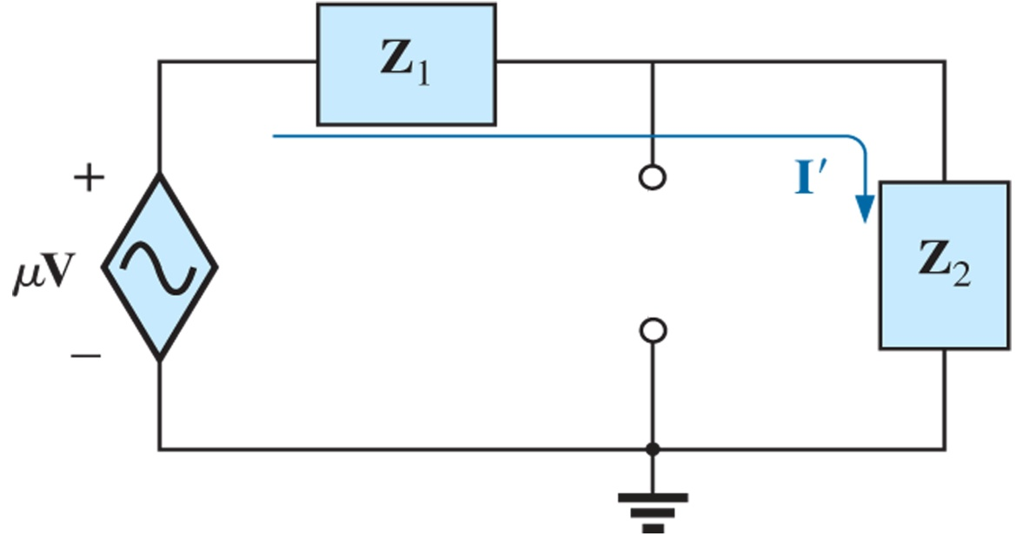
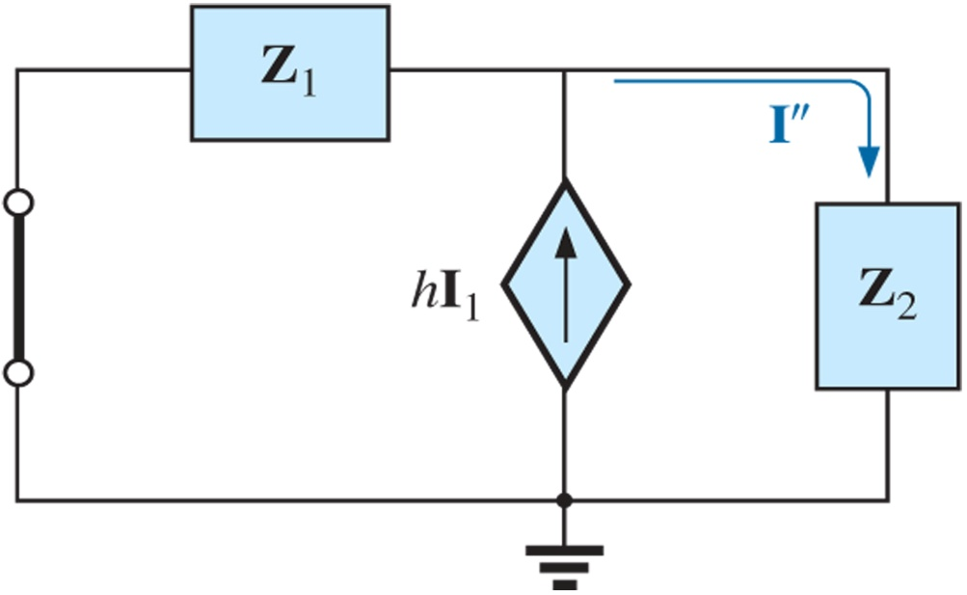
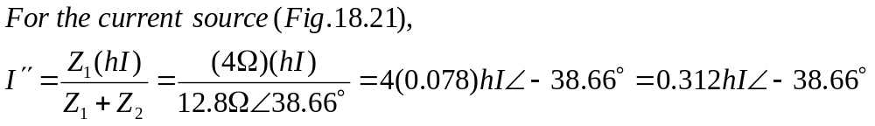
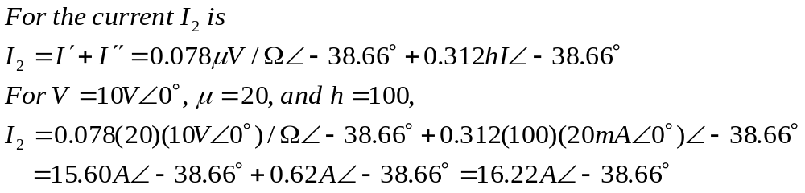
Figure 18.20 Determining the effect of the voltage-controlled voltage source on the current I₂ for the network in Fig.18.18.
Figure 18.21 Determining the effect of the current-controlled current source on the current I₂ for the network in Fig.18.18.
ET 242 Circuit Analysis II – Network Theorems for AC Circuits Boylestad 10

Slide 12
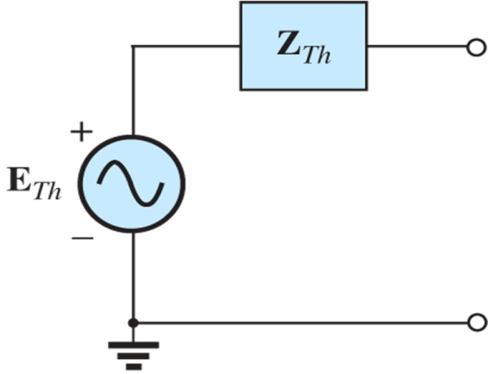
Thevenin’s Theorem
Thevenin’s theorem, as stated for sinusoidal ac circuits, is changed only to include the term impedance instead of resistance, that is,
any two-terminal linear ac network can be replaced with an equivalent circuit consisting of a voltage source and an importance in series, as shown in Fig. 18.23.
Since the reactances of a circuit are frequency dependent, the Thevinin circuit found for a particular network is applicable only at one frequency. The steps required to apply this method to dc circuits are repeated here with changes for sinusoidal ac circuits. As before, the only change is the replacement of the term resistance with impedance. Again, dependent and independent sources are treated separately.
Figure 18.23 Thevenin equivalent circuit for ac networks.
Independent Sources
Remove that portion of the network across which the Thevenin equivalent circuit is to be found.
Mark (o, •, and so on) the terminal of the remaining two-terminal network.
Calculate Z_{TH} by first setting all voltage and current sources to zero (short circuit and open circuit, respectively) and then finding the resulting impedance between the marked terminals.
Calculate E_{TH} by first replacing the voltage and current sources and then finding the open-circuit voltage between the marked terminals.
Draw the Thevenin equivalent circuit with the portion of the circuit previously removed replaced between the terminals of the Thevinin equivalent circuit.
ET 242 Circuit Analysis II – Parallel ac circuits analysis Boylestad 11

Slide 13
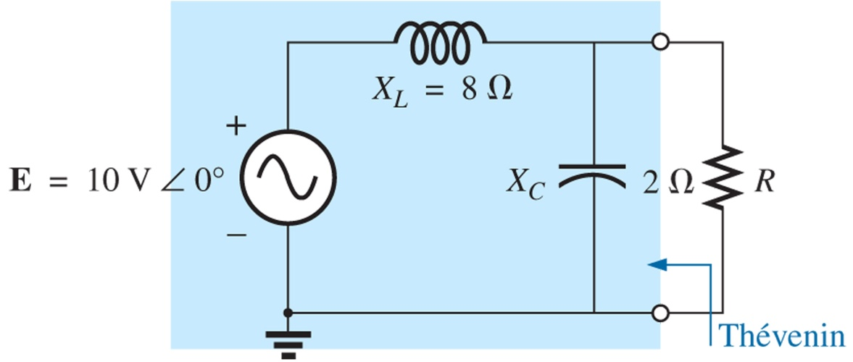
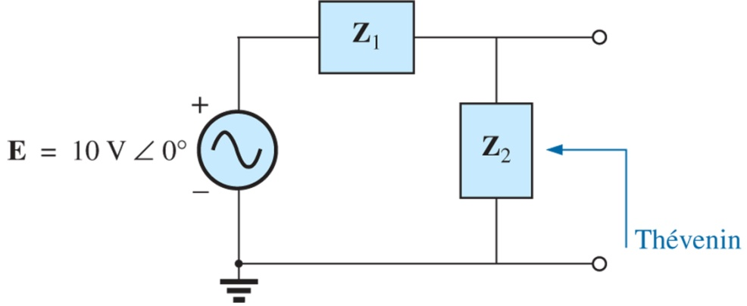
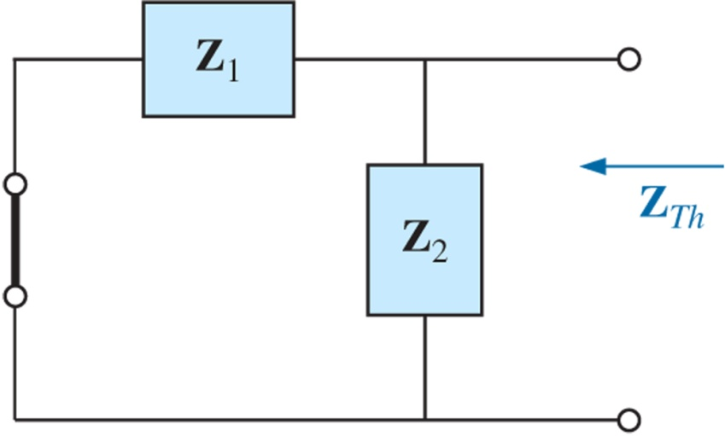
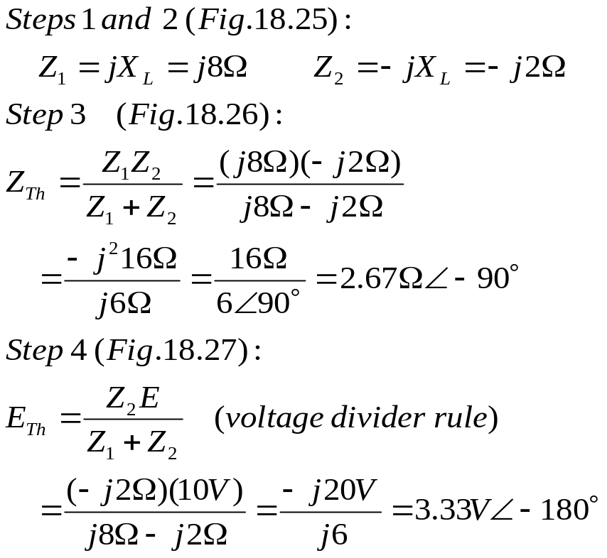
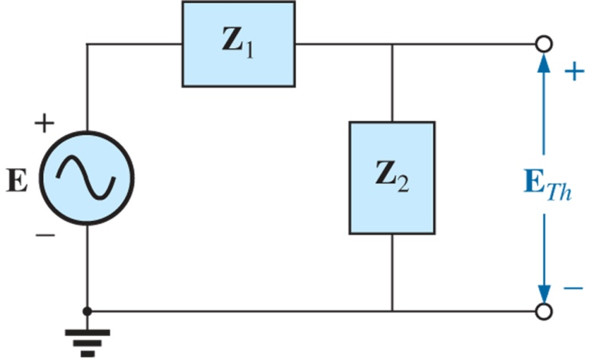
Ex. 18-7 Find the Thevenin equivalent circuit for the network external to resistor R in Fig. 18.24.
Figure 18.25 Assigning the subscripted impedances to the network in Fig.18.24.
Figure 18.24
Example 18.7.
Figure 18.26 Determine the Thevenin impedance for the network in Fig.18.24.
Figure 18.27 Determine the open-circuit Thevenin voltage for the network in Fig.18.24.
ET 242 Circuit Analysis II – Sinusoidal Alternating Waveforms Boylestad 12

Slide 14
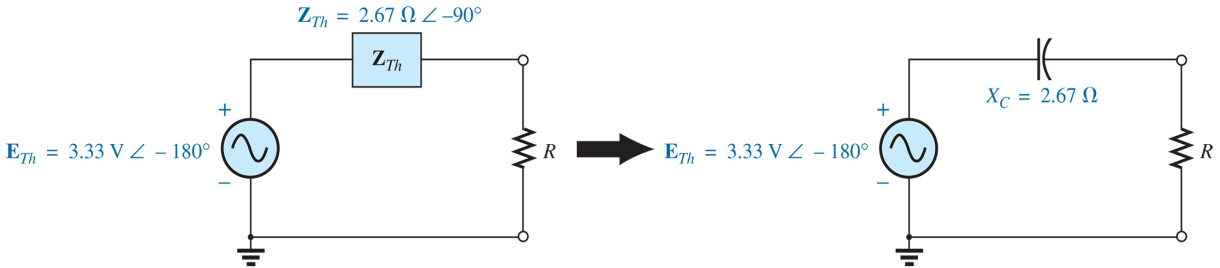
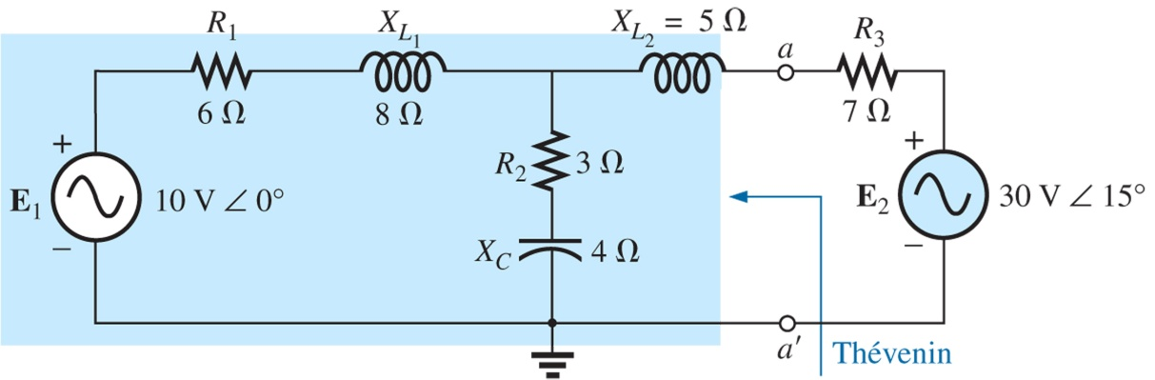
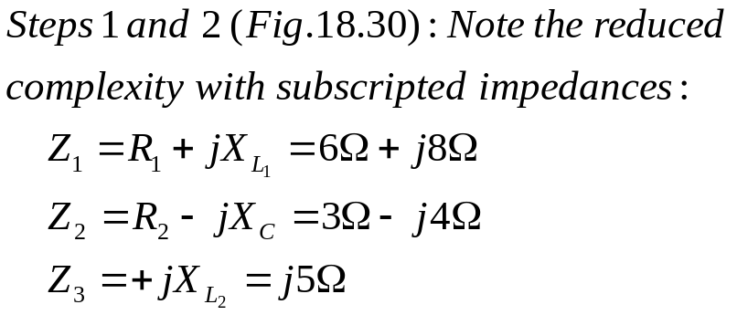
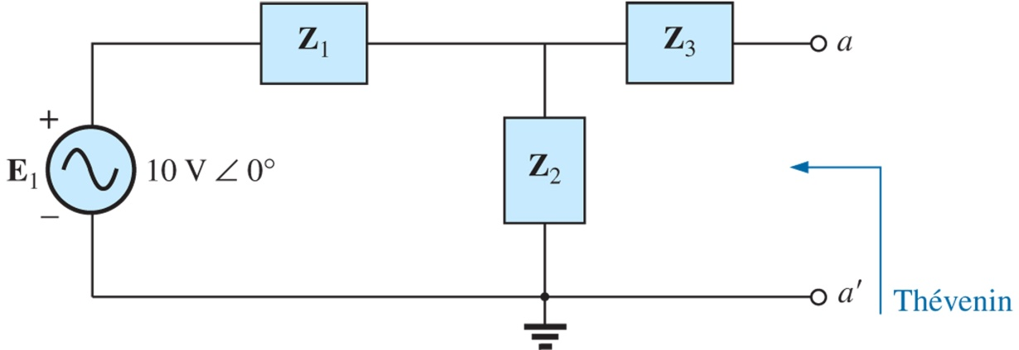
Step 5: The Thevenin equivalent circuit is shown in Fig. 18.28.
Figure 18.28 The Thevenin equivalent circuit for the network in Fig.18.24.
Ex. 18-8 Find the Thevenin equivalent circuit for the network external to resistor to branch a-a´ in Fig. 18.24.
Figure 18.29
Example 18.8.
Figure 18.30 Assigning the subscripted impedances for the network in Fig.18.29.
ET 242 Circuit Analysis II – Parallel ac circuits analysis Boylestad 13

Slide 15
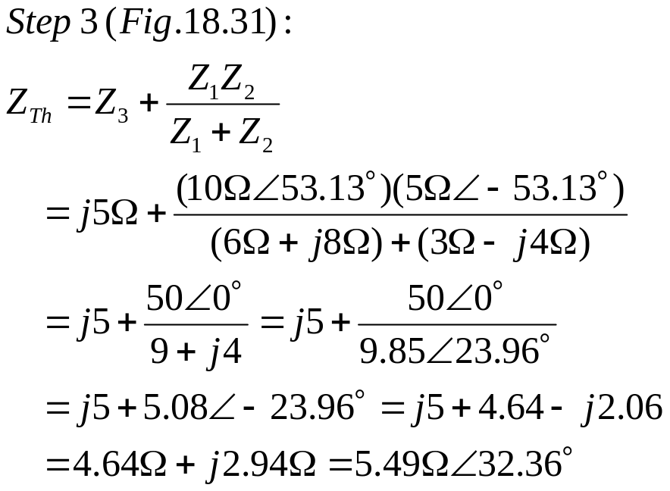
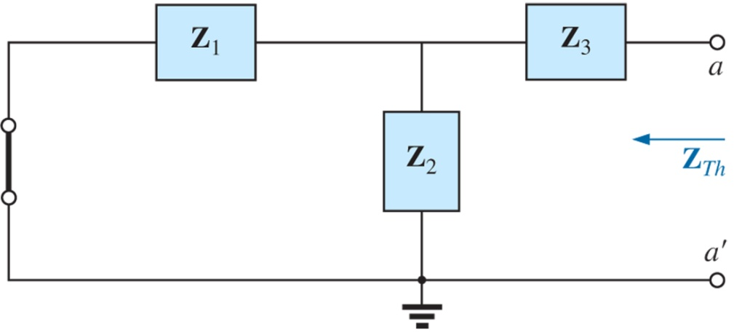
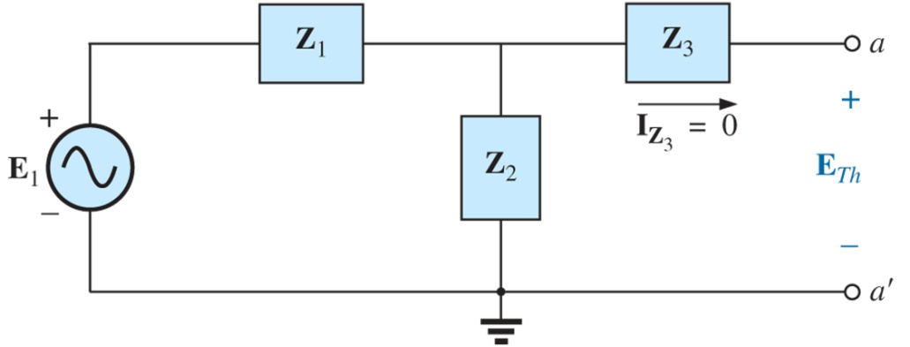
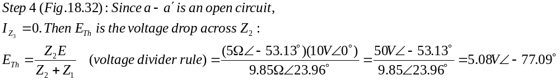
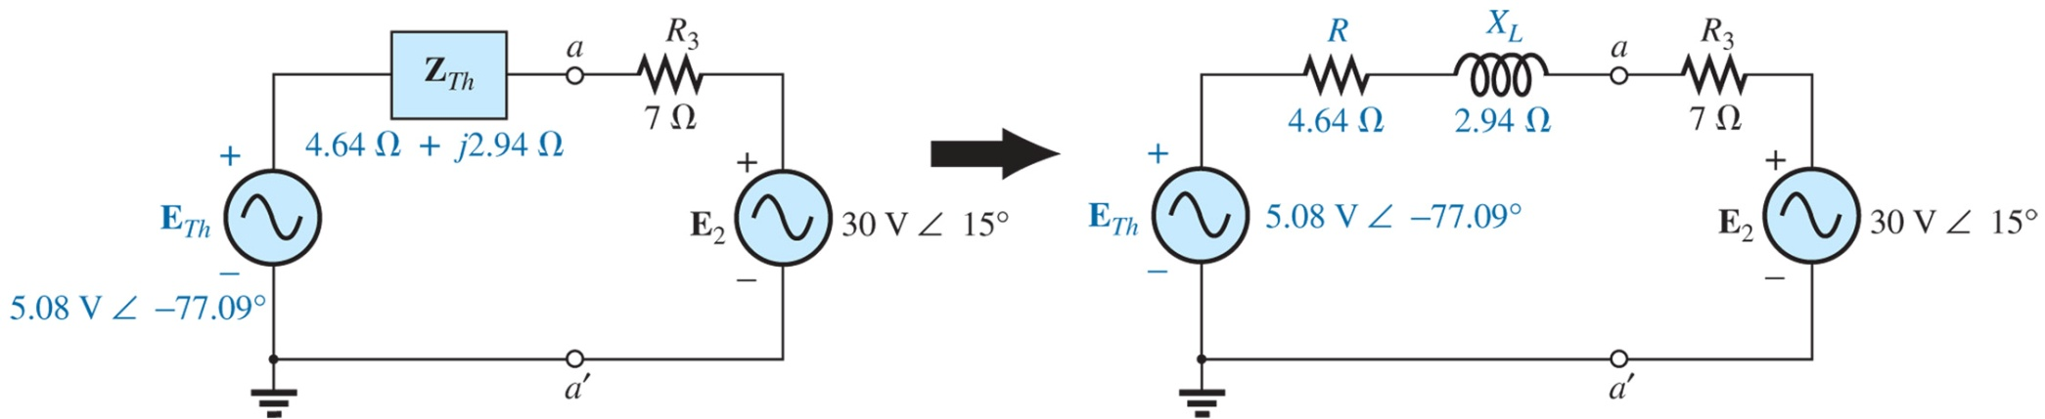
Figure 18.26 Determine the Thevenin impedance for the network in Fig.18.29.
Figure 18.27 Determine the open-circuit Thevenin voltage for the network in Fig.18.24.
Step 5: The Thevenin equivalent circuit is shown in Fig. 18.33.
ET 242 Circuit Analysis II – Selected Network Theorems for AC Circuits Boylestad 14
Figure 18.33 The Thevenin equivalent circuit for the network in Fig.18.29.

Slide 16
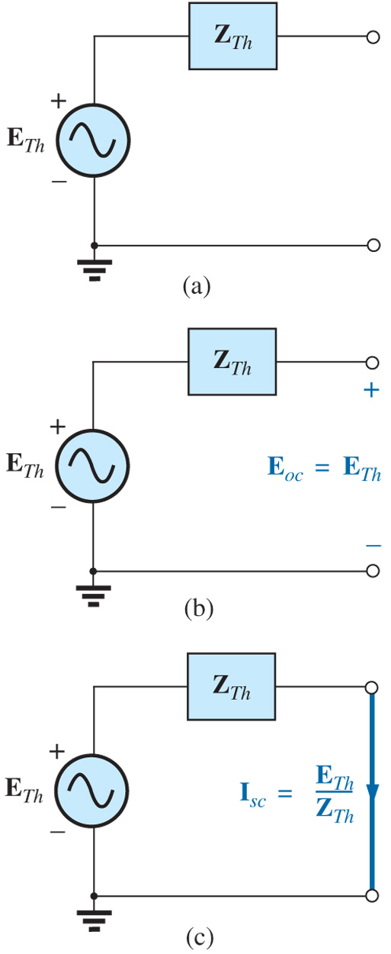
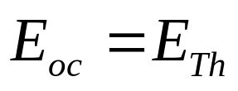
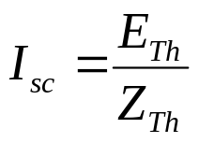
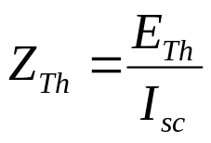
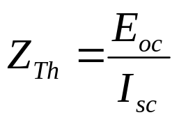
Dependent Sources For dependent sources with a controlling variable not in the network under investigation, the procedure indicated above can be applied. However, for dependent sources of the other type, where the controlling variable is part of the network to which the theorem is to be applied, another approach must be used.
The new approach to Thevenin’s theorem can best be introduced at this stage in the development by considering the Thevenin equivalent circuit in Fig. 18.39(a). As indicated in fig. 18.39(b), the open-circuit terminal voltage (E_{oc}) of the Thevenin equivalent circuit is the Thevenin equivalent voltage; that is
If the external terminals are short circuited as in Fig. 18.39(c), the resulting short-circuit current is determined by
or, rearranged,
and
ET 242 Circuit Analysis II – Selected Network Theorems for AC Circuits Boylestad 15
Figure 18.39 Defining an alternative approach for determining the Thevenin impedance.

Slide 17
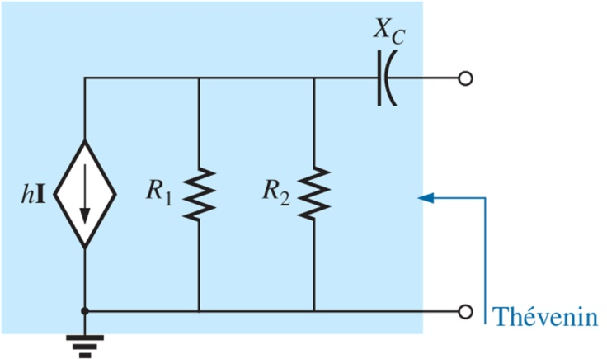
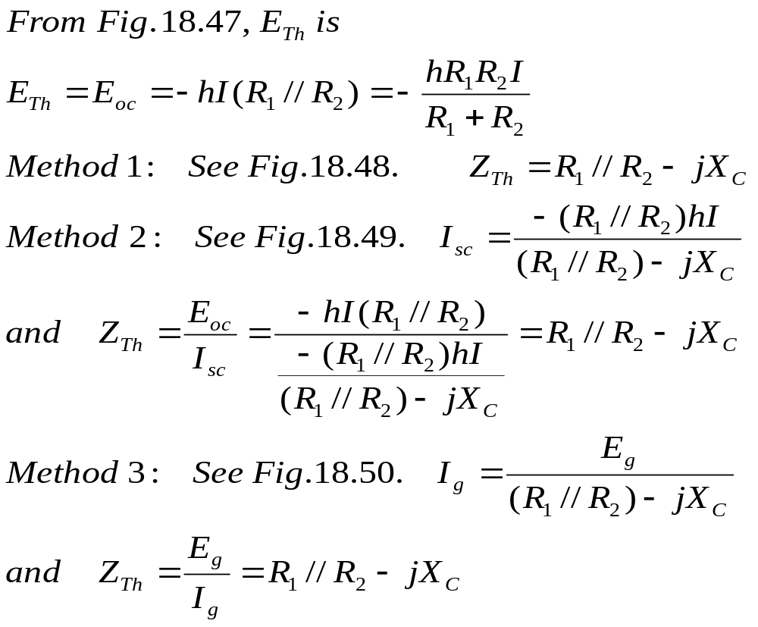



Ex. 18-11 Determine the Thevenin equivalent circuit for the network in Fig. 18.24.
Figure 18.47 Example 18.11.
Figure 18.48 Determine the Thevenin impedance for the network in Fig.18.47.
Figure 18.49 Determine the short-circuit current for the network in Fig.18.47.
Figure 18.50 Determining the Thevenin impedance using the approach Z_{Th} = E_{g}/I_{g}.
ET 242 Circuit Analysis II – Selected Network Theorems for AC Circuits Boylestad 16

Slide 18


Maximum Power Transfer Theorem
When applied to ac circuits, the maximum power transfer theorem states that
maximum power will be delivered to a load when the load impedance is the conjugate of the Thevenin impedance across its terminals.
That is, for Fig. 18.81, for maximum power transfer to the load,
Figure 18.81 Defining the conditions for maximum power transfer to a load.
ET 242 Circuit Analysis II – Network Theorems for AC Circuits Boylestad 17

Slide 19



Figure 18.82 Conditions for maximum power transfer to Z_{L}.
ET 242 Circuit Analysis II – Network Theorems for AC Circuits Boylestad 18

Slide 20




Ex. 18-19 Find the load impedance in Fig. 18.83 for maximum power to the load, and find the maximum power.
Figure 18.83 Example 18.19.
Figure 18.84 Determining (a) Z_{Th} and (b) E_{Th} for the network external to the load in Fig. 18.83.
ET 242 Circuit Analysis II – Selected Network Theorems for AC Circuits Boylestad 19

